Slide 1
Berklee Alumni Working Outside of Music: Paths, Thoughts, and Advice
Prof. Kevin Block-Schwenk
Liberal Arts (Economics & Math)

Slide 2
The Project: Interviewing relatively-recent Berklee alumni with good non-music careers.
Criteria to qualify:
Under 25% of their job is music-related.
Graduated from Berklee within a decade.
Berklee was their first Bachelors Degree.
On track to earn at least $45,000 this year.
At their job for at least 6 months.
Like their field and expect to continue working in it for years.

Slide 3
The Project: Interviewing relatively-recent Berklee alumni with good non-music careers.
Criteria to qualify:
Under 25% of their job is music-related.
Graduated from Berklee within a decade.
Berklee was their first Bachelors Degree.
On track to earn at least $45,000 this year.
At their job for at least 6 months.
Like their field and expect to continue working in it for years.
Three topics:
Describing their current job.
Recounting their path from Berklee to what they do now.
Sharing thoughts and advice.

Slide 4
The Project: Interviewing relatively-recent Berklee alumni with good non-music careers.
Criteria to qualify:
Under 25% of their job is music-related.
Graduated from Berklee within a decade.
Berklee was their first Bachelors Degree.
On track to earn at least $45,000 this year.
At their job for at least 6 months.
Like their field and expect to continue working in it for years.
Three topics:
Describing their current job.
Recounting their path from Berklee to what they do now.
Sharing thoughts and advice.
109 interviews done as of the end of 2017.

Slide 5
The Project: Interviewing relatively-recent Berklee alumni with good non-music careers.
Criteria to qualify:
Under 25% of their job is music-related.
Graduated from Berklee within a decade.
Berklee was their first Bachelors Degree.
On track to earn at least $45,000 this year.
At their job for at least 6 months.
Like their field and expect to continue working in it for years.
Three topics:
Describing their current job.
Recounting their path from Berklee to what they do now.
Sharing thoughts and advice.
109 interviews done as of the end of 2017.
All interviews can be seen at OtherBerkleeAlumni.com. A new interview is posted weekly.

Slide 6
Majors

Slide 7
Majors
“Business” = MBus + Pro
“Tech” = MP&E, EPD, CWP
“Other” = everything else,
including BoCo

Slide 8
Year of Graduation

Slide 9
Principal Instrument / Gender

Slide 10
What They’re Doing Now

Slide 11
What They’re Doing Now -- Broken out by Berklee Major
MBus + Pro.
MP&E, EPD, CWP
Other

Slide 12
Additional (Non-Music) Degrees

Slide 13
Years Until Their Non-Music Career Started

Slide 14
…Excluding Time as a Full-Time Student

Slide 15
Years working in Music

Slide 16
When They Left Music as a Career, They…

Slide 17
“Business” grads were less likely to work in music, but the percentage of music jobs that proved relevant to their non-music career was similar in all 3.
MBus + Pro
MP&E, EPD, CWP
Other

Slide 18
How They Got Their First Non-Music-Career Job

Slide 19
Their First Non-Music-Career Job

Slide 20
Full Details at OtherBerkleeAlumni.com

Slide 21
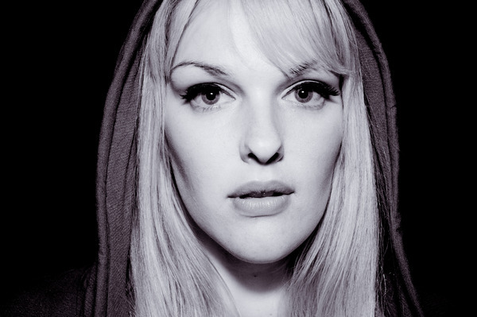
What Berklee Did Well #1 (48; 44%)
Better Thinking
& Learning
Nicole Olver
Pro. Music, 2013
Head of Human Resources (HR)
Bill Langdon
MP&E, 2014
Broadcast Engineer

Slide 22
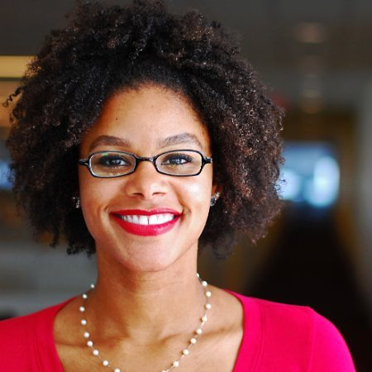
What Berklee Did Well #2 (30; 28%)
Diversity and
Collaboration
Susana Monsalve-Jones
MP&E + Film Scoring, 2013
Management Consultant
MBA
Ama Atobrah
EPD, 2010
Reception Coordinator

Slide 23
What Berklee Did Well #3 (29; 27%)
Focus and Drive
(Incl. Time Management Skills)
Katie Amaral
EPD & MBus, 2009
System Administrator
Masters in Comp. Sci.
Casey Kidd
CWP, 2012
Data Analyst, Entrepreneur

Slide 24
What Berklee Did Well #4 (18; 17%)
Directly-Applicable
Classes
Cambria Russell-Herrera
MBus, 2015
Art (Sculpture) Studio Manager

Slide 25
What Berklee Did Well #5 (16, 15%)
Networking Skills
Anna Eliopoulos
MP&E + Performance, 2008
Radio News Editor

Slide 26
What Berklee Did Well #6 (15, 15%)
Business Skills
Leah Hinton
MBus, 2013
Staffing Coordinator

Slide 27
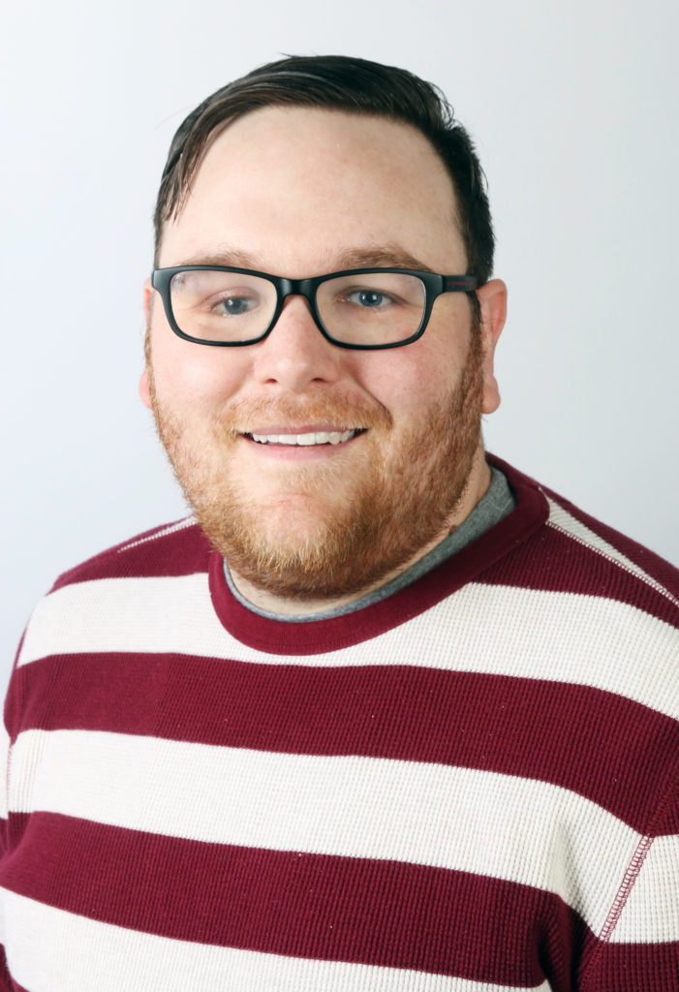
What Berklee Did Well #7 (13, 12%)
Professionalism
Brandon Noke
Pro. Music, 2008
Software QA Engineer
Masters in Sound Recording Tech.

Slide 28
What Berklee did well

Slide 29
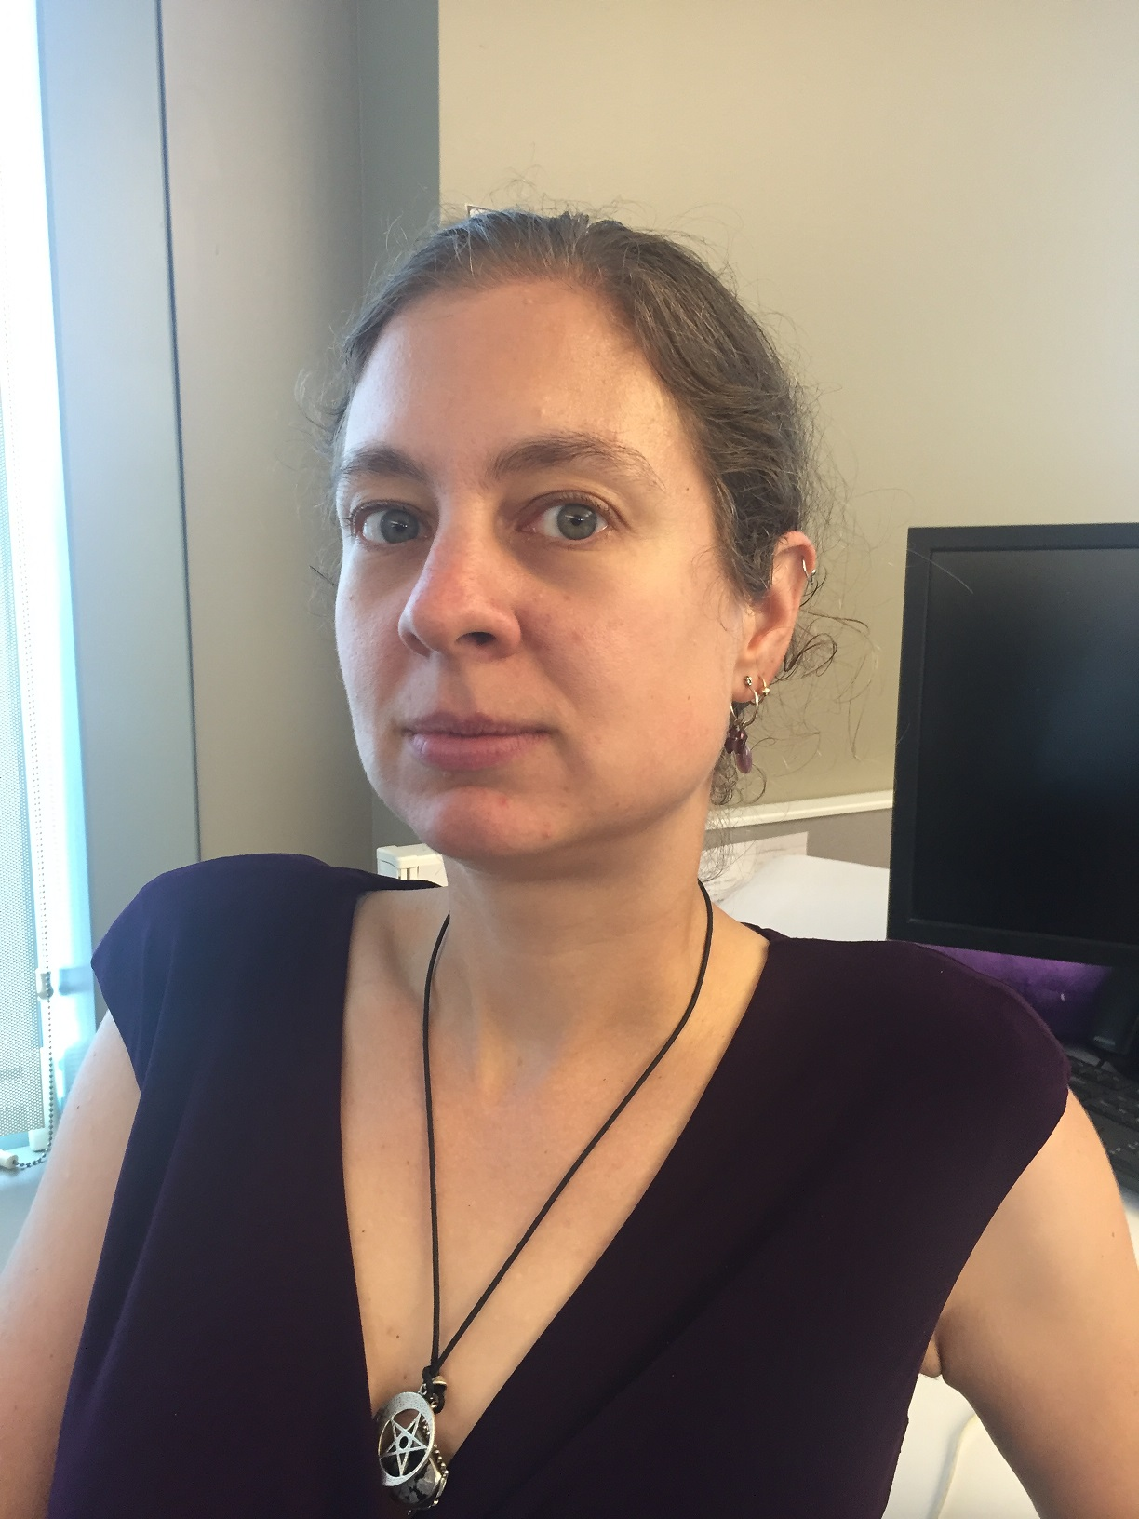
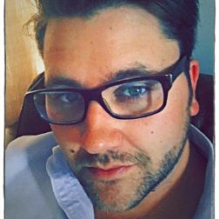
Advice for Current Students #1 (48, 44%)
Seize Opportunities
& Try Things
Dawn-Marie Dunn
EPD + Pro. Music, 2012
Software QA Engineer
Michael Wright,
MBus, 2008
Software Sales

Slide 30
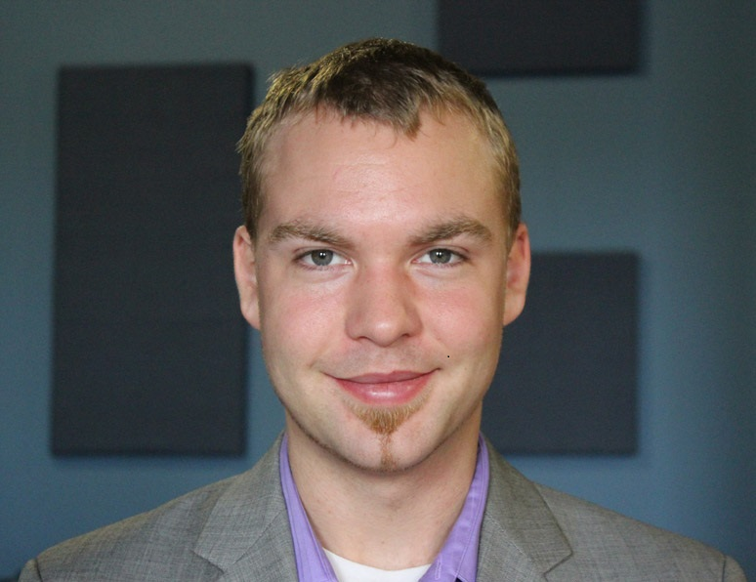
Advice for Current Students #2 (39, 36%)
It’s OK to Work
Outside Music
Eric Devaughn
Performance, 2011
Public School Math Teacher
Josh Nachbar,
MBus, 2014
Technology Consultant

Slide 31
Advice for Current Students #3a (35, 32%)
Network &
Research Careers
John Lahr
MBus, 2016
Dir. of Strategic Partnerships (Sales)
Will Larche,
Musical Theater (BoCo), 2008
Software Engineer

Slide 32
Advice for Current Students #3b (35, 32%)
Figure Out What
You Really Want
John Branch
EPD, 2010
Tech. Support Supervisor

Slide 33
Advice for Current Students #5 (27, 25%)
Be Realistic
(And the first years can be tough.)
Claudia Caliano,
MBus, 2009
Corporate Trainer Consultant

Slide 34
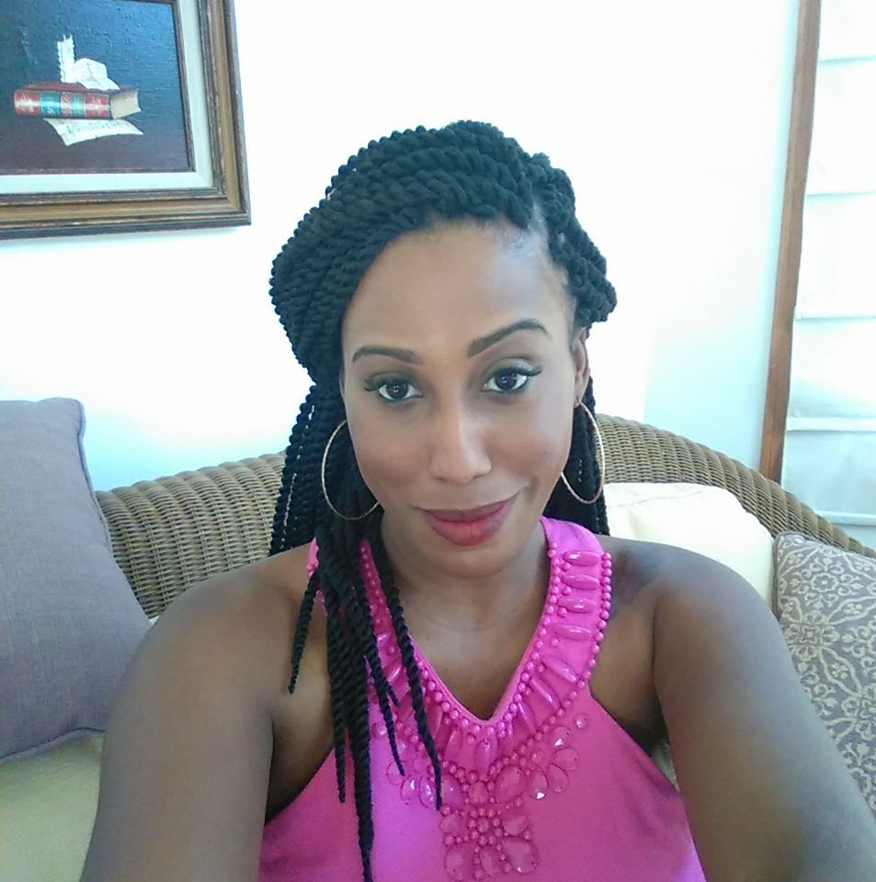
Advice for Current Students #6a (20, 18%)
Work Hard
James Giannoni
Performance, 2016
IT Recruiter
Morgan Mallory,
MBus, 2012
Office Equipment Sales

Slide 35
Advice for Current Students #6b (20, 18%)
Move Forward
Alex Bercow
EPD, 2016 Customer Tech Support

Slide 36
Advice for Current Students #8 (18, 17%)
Be Can-Do
Jared Winegrad,
MBus, 2013
Venture Capital Fund Principal

Slide 37
Advice for Current Students #9 (11, 10%)
Apply your
Music Skills
Sarah Demarco,
MBus, 2009
Fashion Entrepreneur

Slide 38
Advice for Current Students
Also:
Be fiscally responsible. (9)
Get good job search skills. (6)

Slide 39
Current Relationship with Music

Slide 40
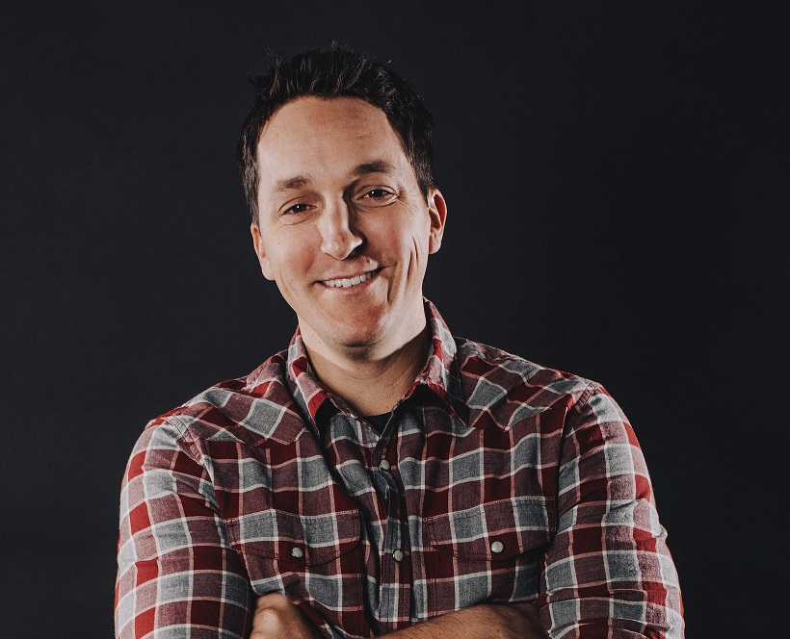
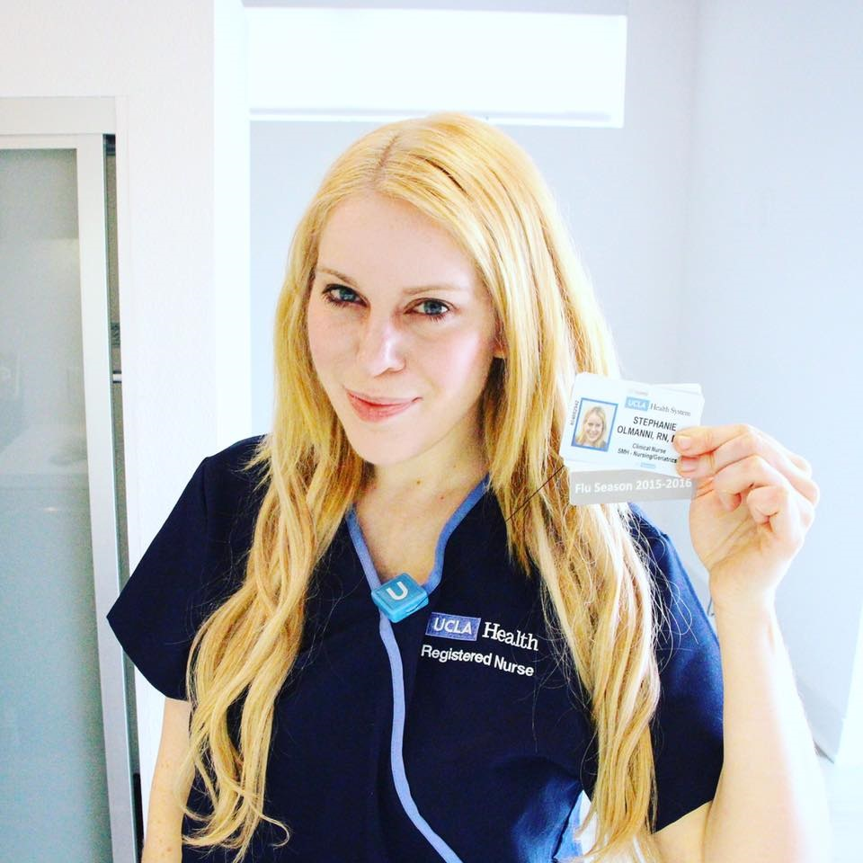
Last Words
Prayre Finley
MBus, 2013
Sub. Teacher, Bakery Mgr, Tutor
Ryan Heenan
MBus, 2007
Marketing Video Entrepreneur
Stephanie Olmanni
Film Scoring + EPD, 2008
Registered Nurse
B.S. in Nursing

Slide 41
Thank you!
Don’t forget to check out OtherBerkleeAlumni.com
Any questions?

Slide 42
No, really.
We’re done here.

Slide 43
Seriously, that’s all I got.
Over and out.

